Slide 1



An Energy-Efficient 3D Point Cloud Neural Network Accelerator With Efficient Filter Pruning, MLP Fusion, and Dual-Stream Sampling
¹Changchun Zhou, ¹Yuzhe Fu, ¹Min Liu, ¹Siyuan Qiu, ¹Ge Li, ²Yifan He, and ¹Hailong Jiao
¹Shenzhen Graduate School, Peking University, Shenzhen, China
²Reconova Technologies Co., Ltd., Xiamen, China
Oct 29 – Nov 2, 2023
San Francisco, California
http://www.PKU-VLSI.com

Slide 2
Outline
Introduction
Optimization Techniques
Experimental Results
Conclusions

Slide 3
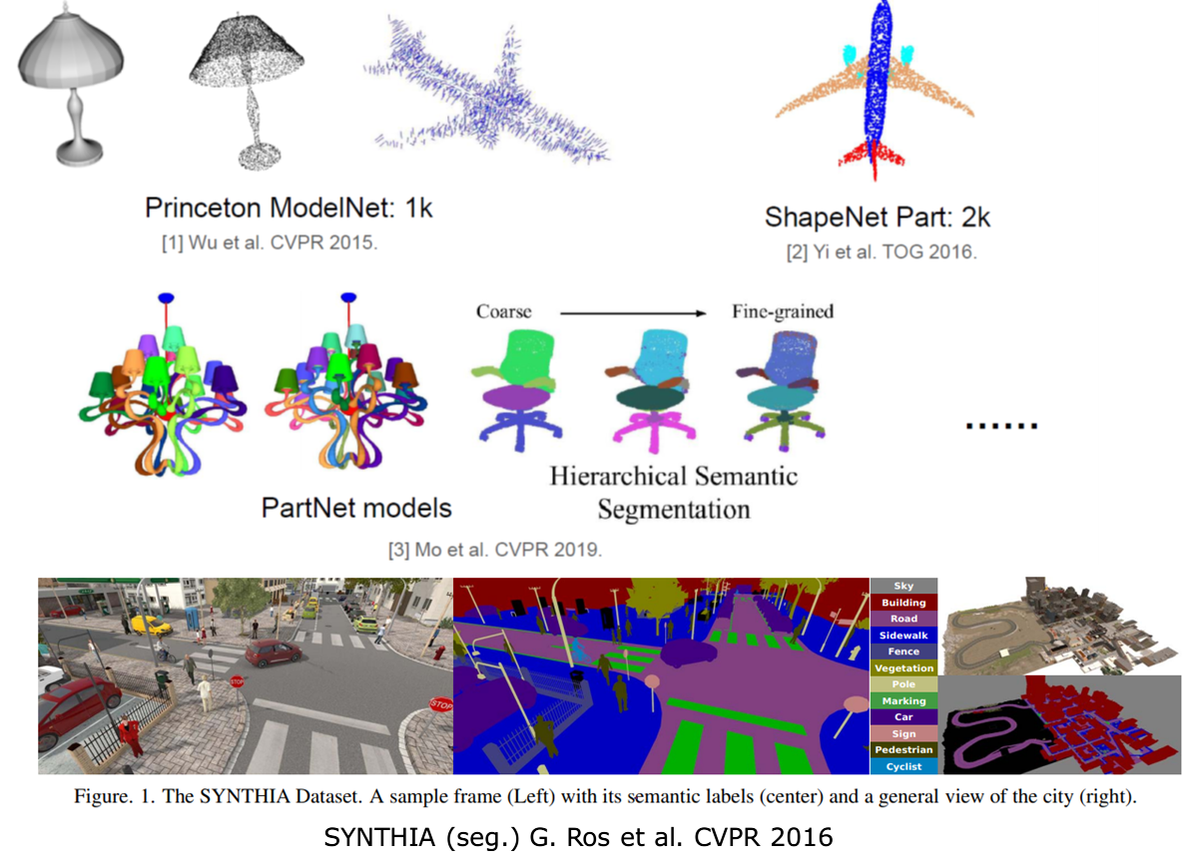

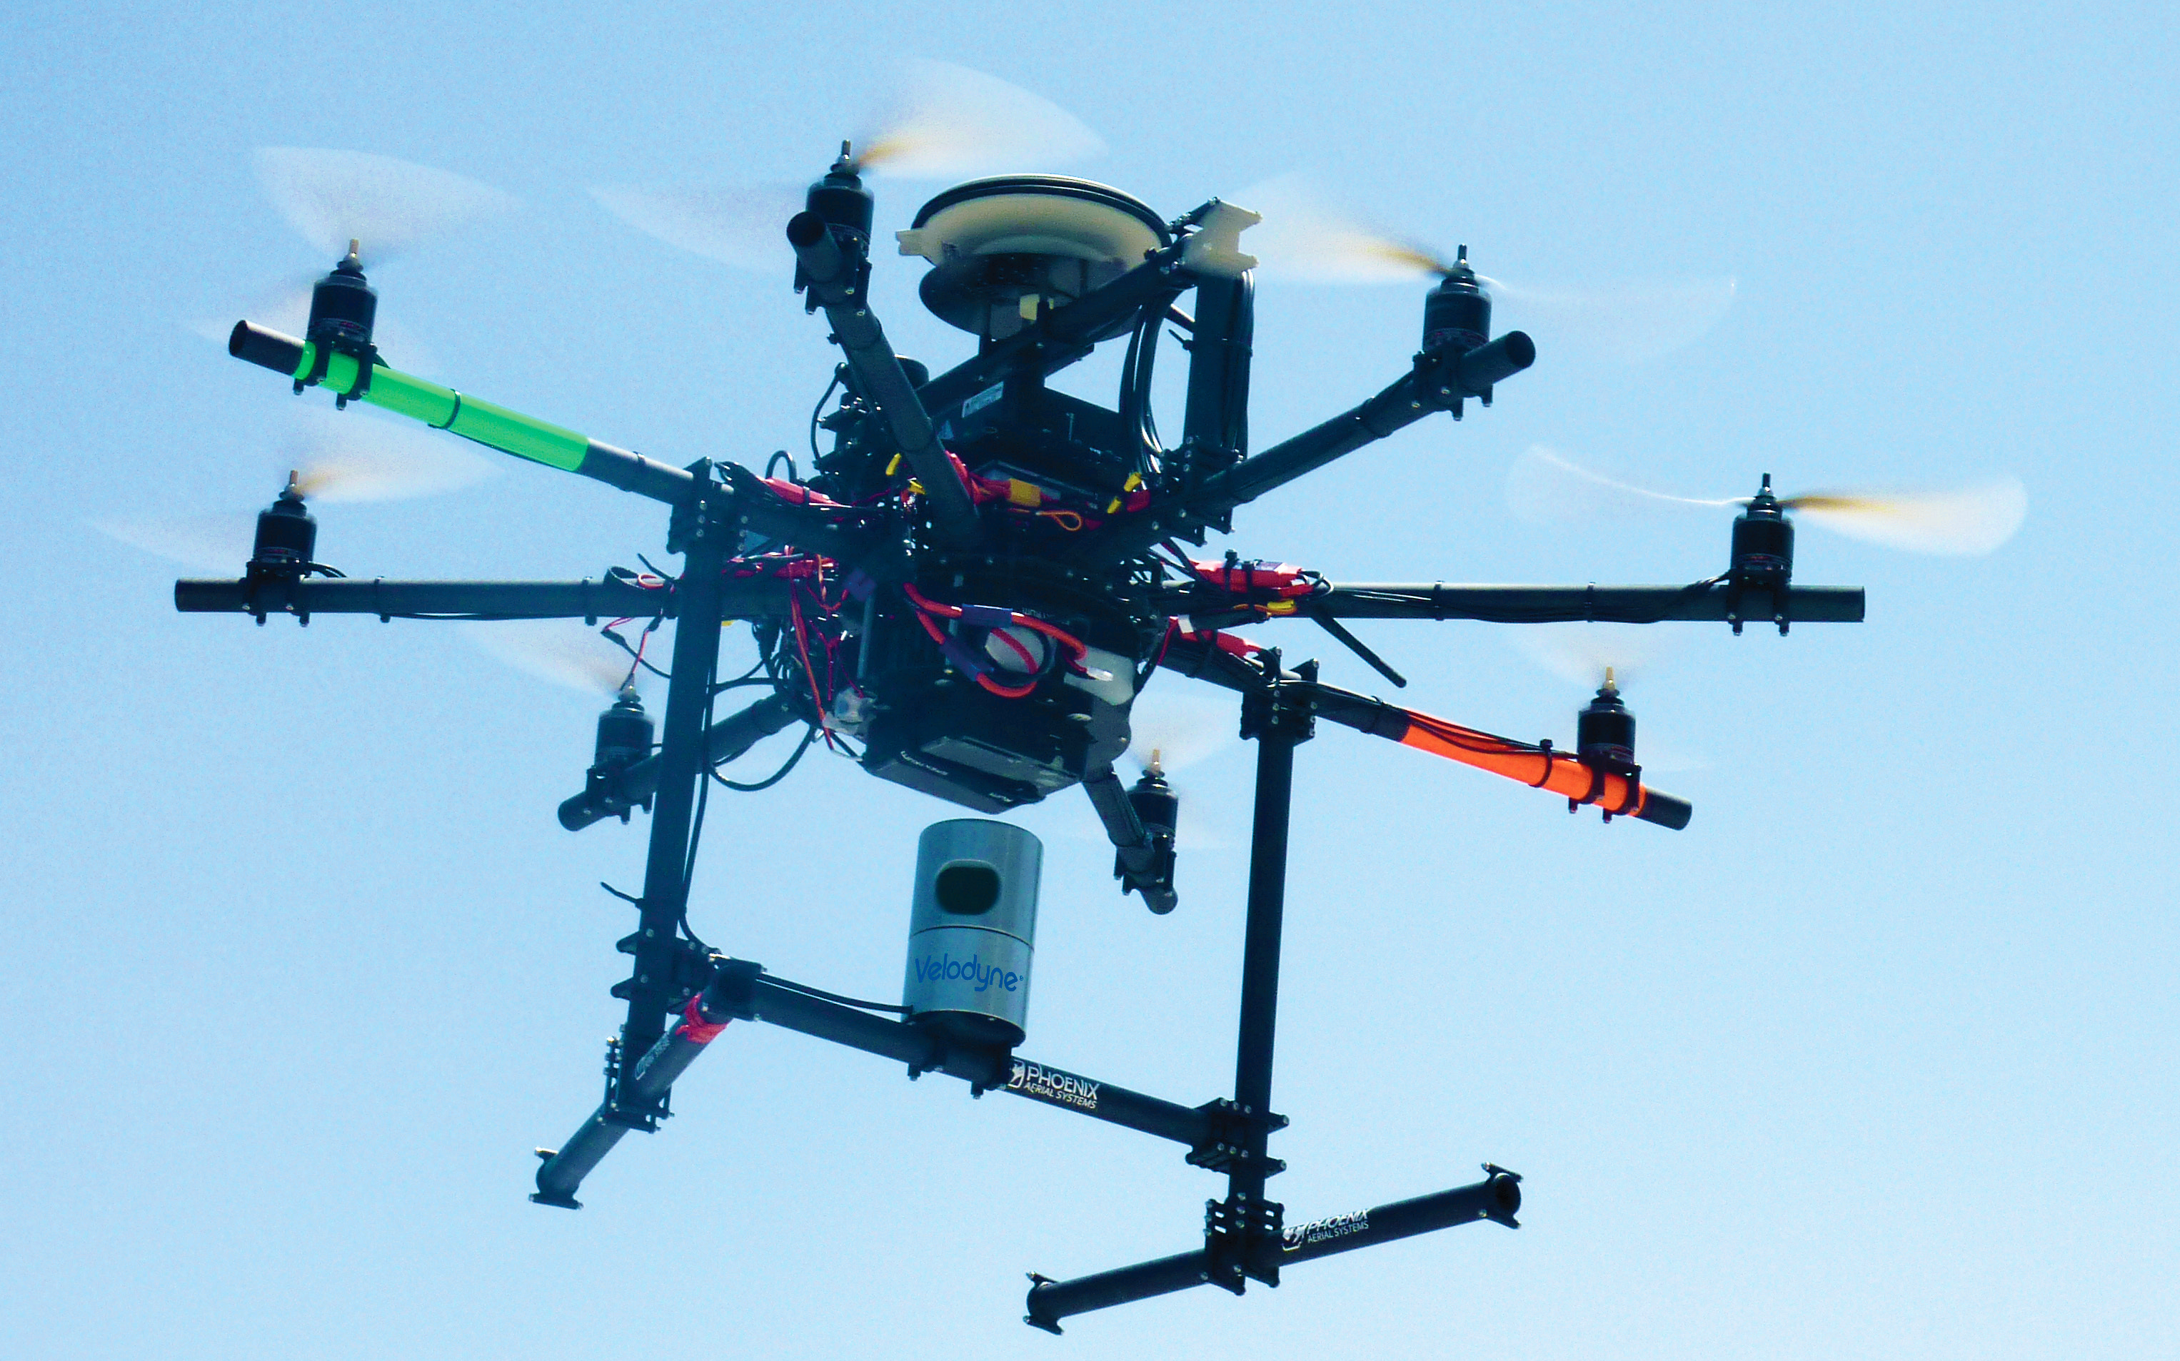
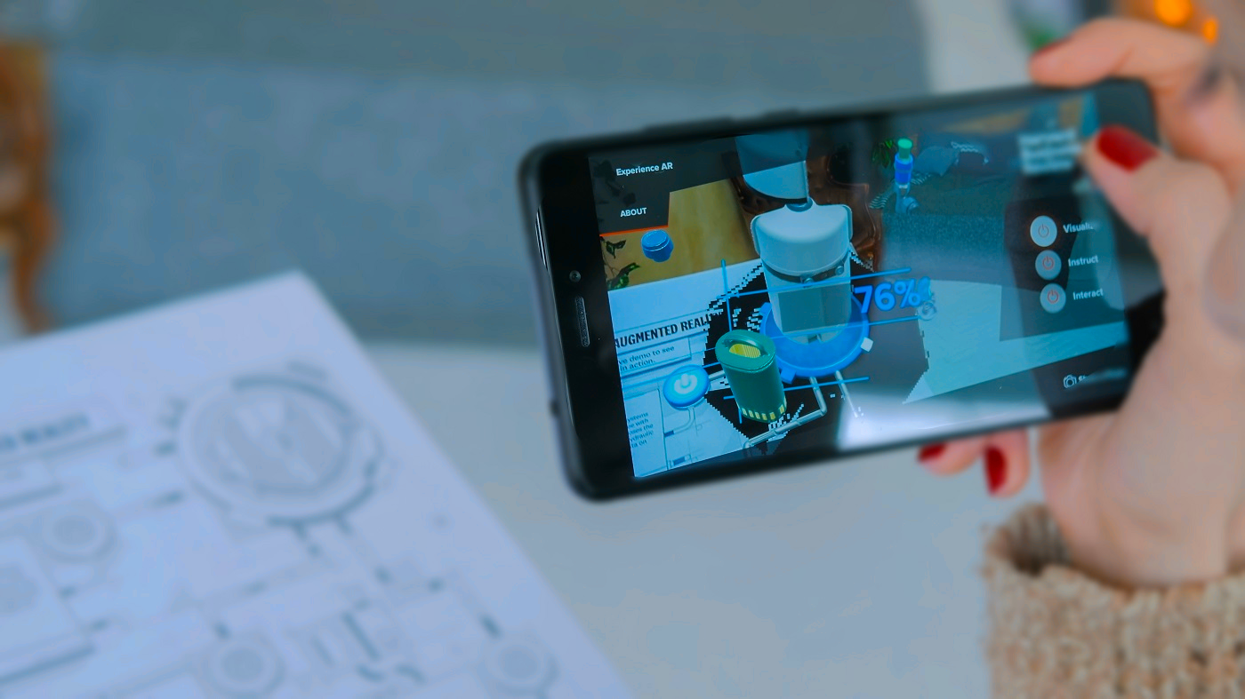
Promising Trend of Point Cloud
Object Classification
Semantic Segmentation
Object Detection
Autonomous Driving
Drone Navigation
Mixed Reality
Z. Wu et al., “3d shapenets: A deep representation for volumetric shapes,” CVPR, 2015, pp. 1912-1920.
I. Armeni et al., “3D Semantic Parsing of Large-Scale Indoor Spaces,” CVPR, 2016, pp. 1534-1543.
Y. Feng et al., “Mesorasi: Architecture support for point cloud analytics via delayed-aggregation,“ MICRO, 2020, pp. 1037-1050.
Notes:
Nowadays, point cloud is widely applied in various deep learning tasks, such as classification, segmentation, and detection. Therefore, point cloud is widely used in various applications, such as driving, navigation, and mixed (mɪkst) reality.

Slide 4
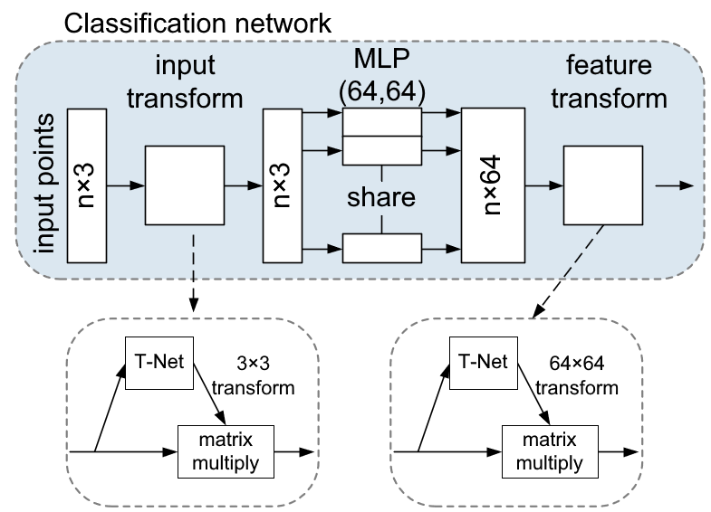
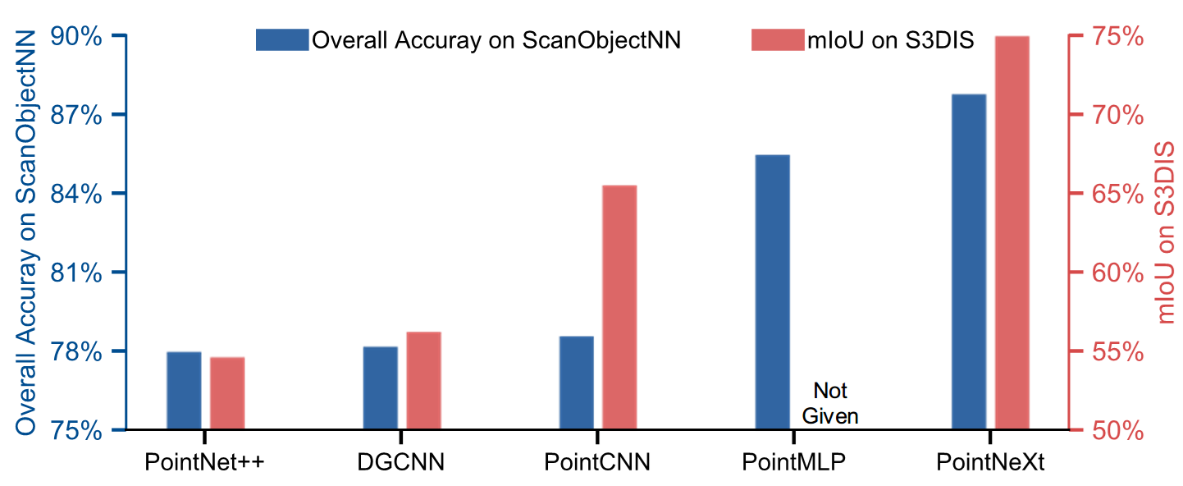
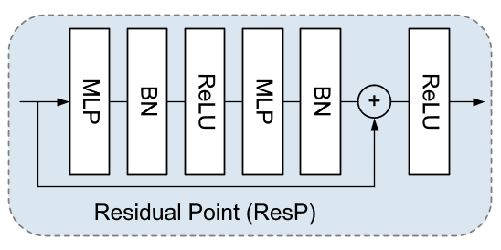
Point Cloud Neural Networks (PNNs)
Disorder and rotation-sensitivity
Hard to extract features
PointNeXt achieves SOTA performance
PointNet
PointNet++
PointNeXt
PointMLP
C. R. Qi et al., “PointNet: Deep learning on point sets for 3D classification and segmentation,” CVPR, 2017, pp. 77-85.
C. R. Qi et al., "PointNet++: Deep hierarchical feature learning on point sets in a metric space,“ NeurIPS, 2017, pp. 5105-5114.
Y. Wang et al., "Dynamic graph CNN for learning on point clouds," ACM Trans. Graph., vol. 38, no. 5, pp. 1-12, 2019.
X. Ma et al., "Rethinking network design and local geometry in point cloud: A simple residual MLP framework,“ ICLR, 2022.
Y. Li et al., "Pointcnn: Convolution on X-transformed points“, NeurIPS, 2018.
G. Qian et al., "PointNeXt: Revisiting PointNet++ with improved training and scaling strategies," NeurIPS, 2022, pp. 23192-23204.
Notes:
Unfortunately, disorder and rotation-sensitivity in point cloud makes it hard to extract features. Therefore, point cloud neural networks (PNN) are developed. By introducing transformation matrix and max-pooling, PointNet solve disorder and rotation-sensitivity. Then, the sampling and grouping are introduced in PointNet++ network to extract local features better. The residual structure is introduced in PointMLP network. Recently, PointNeXt network uses a new training strategy and adjusts the residual /rɪˈzɪdʒuəl/ structure, and thus achieves the best performance. Therefore, PointNeXt is used as benchmark.

Slide 5
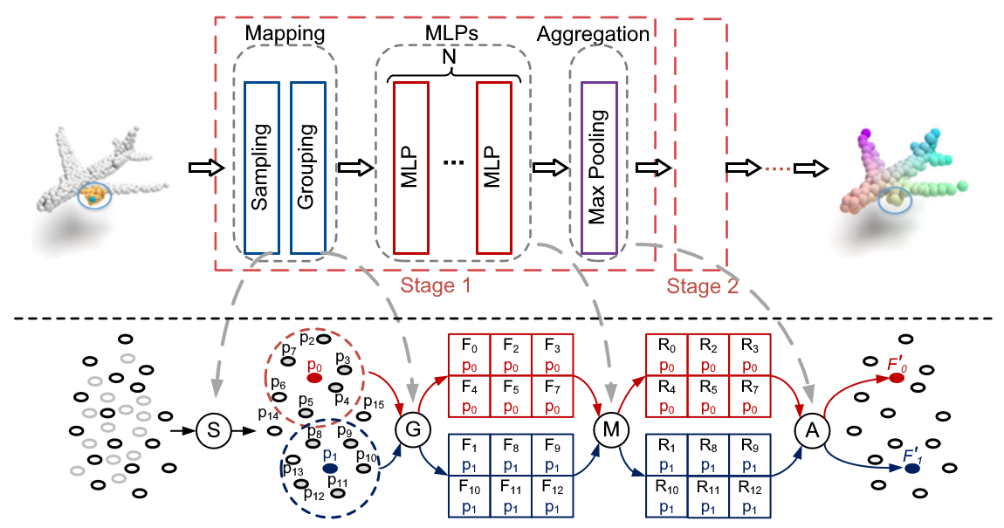
Backbone of PNNs
Each stage contains
A mapping layer
Sampling
Grouping
Consecutive multi-layer perceptrons (MLPs)
1×1 kernel
An aggregation layer
Max-pooling
Notes:
The architecture of PNNs usually contains several stages, and each stage contains a mapping layer, several consecutive MLPs, and an aggregation layer. The mapping layer contains sampling and grouping operations, used to build a relationship between the input and output point clouds. After mapping layer, the features of input points are grouped, and then convolved through consecutive MLPs. Finally, the aggregation layer aggregates the feature groups usually by max-pooling, to obtain the output features. Here is the architecture of PointNeXt network, which contains 5 stages.

Slide 6
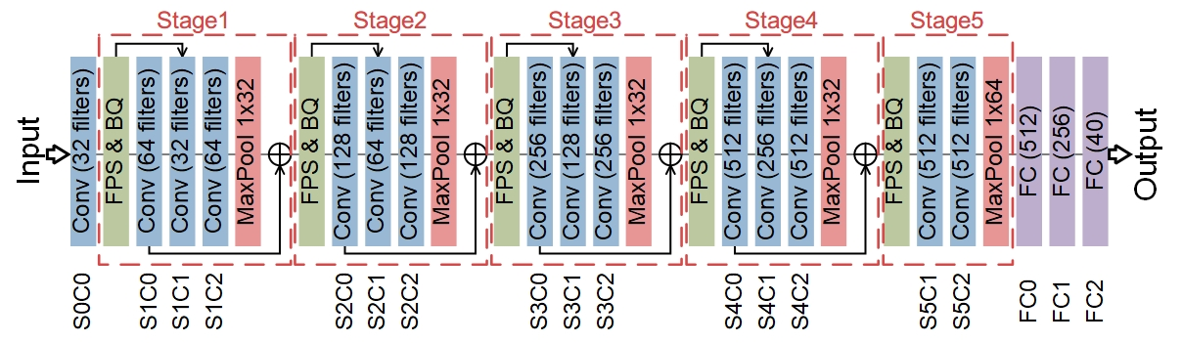
Benchmark: PointNeXt-S Network
5 stages
Residual structure
G. Qian et al., "PointNeXt: Revisiting PointNet++ with improved training and scaling strategies," NeurIPS, 2022, pp. 23192-23204.
Notes:
The architecture of PNNs usually contains several stages, and each stage contains a mapping layer, several consecutive MLPs, and an aggregation layer. The mapping layer contains sampling and grouping operations, used to build a relationship between the input and output point clouds. After mapping layer, the features of input points are grouped, and then convolved through consecutive MLPs. Finally, the aggregation layer aggregates the feature groups usually by max-pooling, to obtain the output features. Here is the architecture of PointNeXt network, which contains 5 stages.

Slide 7
Challenges of PNN Deployment on Edge Devices
Memory Access
Computation Bottleneck
Large amount of memory access
Large number of parameters
Low data reuse due to 1×1 kernel
Low memory access efficiency
Irregular memory access in sampling and grouping
High computation complexity
Convolution in MLPs
Sequential operations
Low computation parallelism
Hight computation complexity and latency 𝑂(𝑁²), N = #Points
Notes:
However, the edge deployment of PNNs is faced with two challenges: memory access and computation bottleneck. The large parameters and low data reuse of 1×1 kernel size in PNNs, cause large amount of off-chip memory access. Meanwhile, irregular memory access in grouping and sampling operations reduces the memory access efficiency. For computation bottleneck, convolution dominates in computation, thus introducing high computational complexity. And the sequential operations in sampling such as Farthest Point Sampling (FPS) leads to low computation parallelism, high latency, and computational complexity.

Slide 8
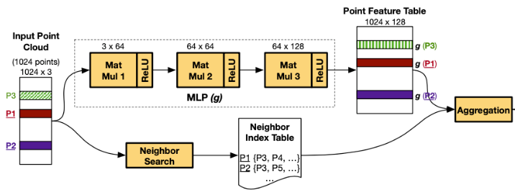
Existing Works: Mesorasi
Delayed-Aggregation
Feature reuse
Operation elimination
Accuracy loss
Y. Feng et al., “Mesorasi: Architecture support for point cloud analytics via delayed-aggregation,” MICRO, 2020, pp. 1037-1050.
Notes:
For the existing works, Mesorasi uses a delayed-aggregation method to increase the feature reuse. But it exchanges the order of convolution and grouping in PNNs and thus degrades the network accuracy. PNNPU partitions point cloud into blocks and then performs intra-block sampling to reduce the complexity of mapping operations and eliminate the irregular off-chip memory access of MLPs. However, the proposed intra-block sampling method also degrades the network accuracy in small-scale scenarios /səˈnærioʊz/. PointAcc uses a configurable mapping hardware to support multiple types of mapping operations. However, the off-chip memory access is large and the reuse rate of the mapping hardware is low.

Slide 9
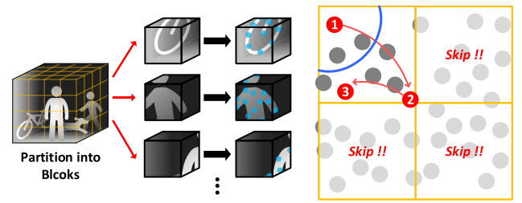
Existing Works: PNNPU
Block-wise Sampling
Operation skipping
Parallelism improvement
Accuracy loss
S. Kim et al., "PNNPU: A 11.9 TOPS/W highspeed 3D point cloud-based neural network processor with block-based point processing for regular DRAM access,“ IEEE Symp. VLSI Circuits, 2021, pp. 1-2.
Notes:
For the existing works, Mesorasi uses a delayed-aggregation method to increase the feature reuse. But it exchanges the order of convolution and grouping in PNNs and thus degrades the network accuracy. PNNPU partitions point cloud into blocks and then performs intra-block sampling to reduce the complexity of mapping operations and eliminate the irregular off-chip memory access of MLPs. However, the proposed intra-block sampling method also degrades the network accuracy in small-scale scenarios /səˈnærioʊz/. PointAcc uses a configurable mapping hardware to support multiple types of mapping operations. However, the off-chip memory access is large and the reuse rate of the mapping hardware is low.

Slide 10
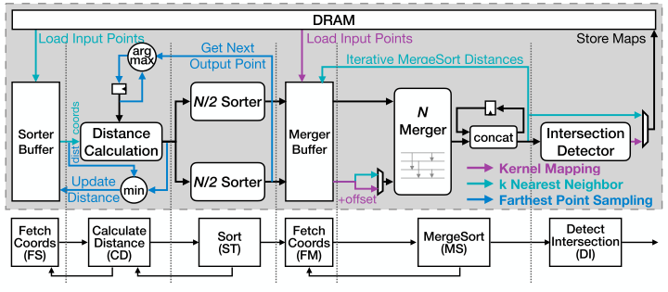
Existing Works: PointAcc
Configurable Mapping Hardware
Multiple mapping operations
Large memory access
Low hardware reuse
Y. Lin et al., "PointAcc: Efficient point cloud accelerator,“ MICRO, 2021, pp. 449-461.
Notes:
For the existing works, Mesorasi uses a delayed-aggregation method to increase the feature reuse. But it exchanges the order of convolution and grouping in PNNs and thus degrades the network accuracy. PNNPU partitions point cloud into blocks and then performs intra-block sampling to reduce the complexity of mapping operations and eliminate the irregular off-chip memory access of MLPs. However, the proposed intra-block sampling method also degrades the network accuracy in small-scale scenarios /səˈnærioʊz/. PointAcc uses a configurable mapping hardware to support multiple types of mapping operations. However, the off-chip memory access is large and the reuse rate of the mapping hardware is low.

Slide 11
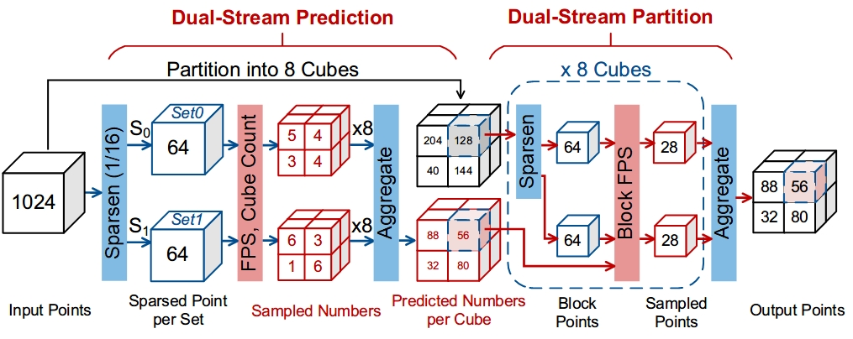
Contributions of This Work
An Energy-Efficient 3D Point Cloud Neural Network Accelerator
Efficient filter pruning (EFP)
Convolution dominates in computation and storage
Skip redundant filters and activations
Block-wise MLP fusion (BMF)
Large off-chip memory access of features
Improve on-chip reuse
Dual-Stream Block-wise FPS (DSBF)
High latency and high complexity
Improve parallelism, reduce latency, and maintain accuracy
Notes:
The first part is efficient filter pruning.

Slide 12
Outline
Introduction
Optimization Techniques
Experimental Results
Conclusions

Slide 13
Challenge I
Large parameters in MLPs
Convolution domination
Unstructured element sparsity
Unfriendly for acceleration
Notes:
In PNNs, large parameters in MLPs make convolutions still dominate computations and data storage, which brings high energy consumption and long latency. Second, unstructured element sparsity of quantized PNNs is not friendly for hardware acceleration. To solve these issues, we explored three characteristics in PNNs. First, since the contribution varies greatly across filters, some less important filters can be directly pruned without accuracy loss. Second, in the MLPs of PNNs, the correlation between filters and output features are weak because filters are reused in only one dimension across features, rather than in two dimensions such as 2D-CNN. Therefore, in PNNs, more filters can be pruned. Additionally, the pruned filters in the current layer can also introduce corresponding zero-value channels of input feature and filters in the next layer, which further improves the channel sparsity of both features and filters.

Slide 14
Solution: Efficient Filter Pruning (EFP)
Varied contribution
Prune less important filters
Weak correlation
Prune more filters
Zero-value channels
Increase channel sparsity
Notes:
In PNNs, large parameters in MLPs make convolutions still dominate computations and data storage, which brings high energy consumption and long latency. Second, unstructured element sparsity of quantized PNNs is not friendly for hardware acceleration. To solve these issues, we explored three characteristics in PNNs. First, since the contribution varies greatly across filters, some less important filters can be directly pruned without accuracy loss. Second, in the MLPs of PNNs, the correlation between filters and output features are weak because filters are reused in only one dimension across features, rather than in two dimensions such as 2D-CNN. Therefore, in PNNs, more filters can be pruned. Additionally, the pruned filters in the current layer can also introduce corresponding zero-value channels of input feature and filters in the next layer, which further improves the channel sparsity of both features and filters.

Slide 15
Efficient Filter Pruning (EFP): Improvements
Tool: Distiller
Overall filter pruning rate: 78%
Improvement of channel sparsity
Features: 15.7% to 61.78%
Filters: 1.2% to 96.6%
Distiller. Accessed: Oct. 28, 2023. [Online]. Available: https://github.com/IntelLabs/distiller.
Notes:
We perform the EFP on PointNeXt network with a 78% overall filter pruning rate. You can see, EFP improves channel sparsity significantly and thus greatly reduces computational complexity and model parameters.

Slide 16
Efficient Filter Pruning (EFP): Improvements
Tool: Distiller
Overall filter pruning rate: 78%
Computation complexity: 91.9%↓
Model parameters: 96.6%↓
12. Distiller. Accessed: Oct. 28, 2023. [Online]. Available: https://github.com/IntelLabs/distiller.
Notes:
We perform the EFP on PointNeXt network with a 78% overall filter pruning rate. You can see, EFP improves channel sparsity significantly and thus greatly reduces computational complexity and model parameters.

Slide 17
Challenge II
Grouping dilates features by K×
Features >> Filters
1×1 kernel in MLPs
Feature reuse reduction
Conventional dataflow
Complete feature convolution
Large off-chip memory access
Notes:
In PNNs, grouping dilates /daɪˈleɪts/ features by K times, K is the number of required neighbor points, causing features much larger than filters. 1 times 1 kernel size of MLPs lowers the on-chip reuse of features. And in the conventional dataflow, the features of current MLP must be convolved completely, then the next MLP would begin. All of these would cause low hardware utilization and large off-chip memory access.

Slide 18
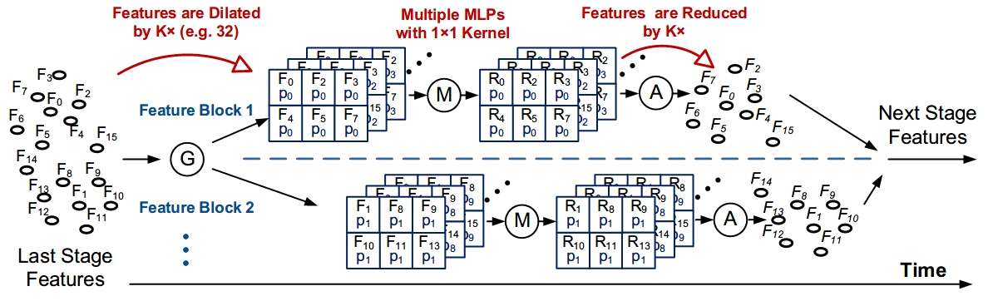
Observations
Consecutive multiple MLPs
Feature reuse
1×1 kernel in MLPs
Partition without padding
Notes:
We notice that, in PNNs, the consecutive multiple MLPs enables the reuse of features across MLPs. What’s more, the 1×1 kernel size of MLPs enables direct partition of the features without complex padding processing. Based on these, we propose a block-wise MLP fusion method. For at the begin of each stage in PNN, BMF partitions the input features into feature blocks, and then each feature block is performed group, consecutive MLPs and pooling to shorten and grouping and aggregation latency, and increase on-chip reuse of features. In hardware implementation, the filters are pre-stored on chip. Therefore, a feature block dataflow loop is built between the memory module and the convolution module, enabling multiple times on-chip reuse of feature blocks across MLPs.

Slide 19
Solution: Block-wise MLP Fusion (BMF)
Step 1: Partition point cloud into blocks
Memory access ↓
Grouping
Consecutive MLPs
Pooling
Grouping latency ↓
Step 2: Each block
Features reuse ↑
Aggregation Latency ↓
Step 3: Gather output points
Feature block dataflow loop
Notes:
We notice that, in PNNs, the consecutive multiple MLPs enables the reuse of features across MLPs. What’s more, the 1×1 kernel size of MLPs enables direct partition of the features without complex padding processing. Based on these, we propose a block-wise MLP fusion method. For at the begin of each stage in PNN, BMF partitions the input features into feature blocks, and then each feature block is performed group, consecutive MLPs and pooling to shorten and grouping and aggregation latency, and increase on-chip reuse of features. In hardware implementation, the filters are pre-stored on chip. Therefore, a feature block dataflow loop is built between the memory module and the convolution module, enabling multiple times on-chip reuse of feature blocks across MLPs.

Slide 20
Block-wise MLP Fusion (BMF): Improvements
Off-chip memory access reduction: 95.3%↓
EFP reduces filters and features
Act on large grouped features
Reduce off-chip memory access
Improve hardware utilization
Notes:
EFP reduce 95.3% off-chip memory access. This effectiveness is attributed (əˈtrɪbjuːtɪd) to two aspects. First, EFP reduces the size of both filters and features, enabling them to be stored on-chip. Secondly, the block partition in BMF eliminates the off-chip memory access of the large grouped point features.

Slide 21
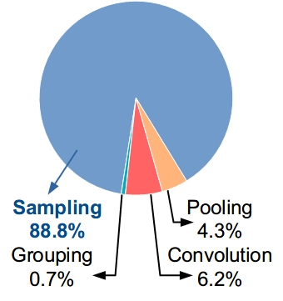
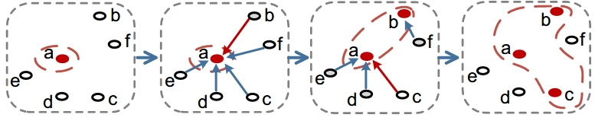
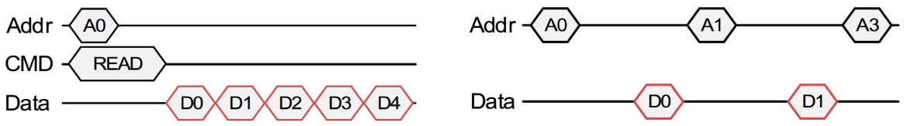
Challenge III
Inherently sequential processing
High computational complexity
Latency bottleneck
e.g., up to 80× longer processing time than systolic array
Irregular memory access
Notes:
The original FPS processing is sequential with a high computational complexity and irregular memory access make FPS become the latency bottleneck. To address these challenges, we propose a dual-stream block-wise FPS. There are two steps in DSBF: dual-stream prediction and dual-stream partition. In dual-stream prediction, the original input point cloud is down-sampling into two small sets. Then, the two small point sets are performed FPS and then count intra-block points as the number of output points in each block. In dual-stream partition, the input point cloud is spatially partitioned into cubes firstly to maintain the global feature of point cloud. Then, each cube is evenly sampled into two blocks to improve FPS parallelism. Based on the predicted number from the first step, intra-block FPS is performed and finally, gather remained points of all blocks to obtain the output points of current FPS layer.

Slide 22
Solution: Dual-Stream Block-wise FPS (DSBF)
Dual-stream prediction
Two intra-set FPS
Count intra-block points
Improve prediction accuracy
Dual-stream partition
Spatially partitioned into cubes
Evenly sample each cube into two blocks
Maintain global features
Improve parallelism
Notes:
The original FPS processing is sequential with a high computational complexity and irregular memory access make FPS become the latency bottleneck. To address these challenges, we propose a dual-stream block-wise FPS. There are two steps in DSBF: dual-stream prediction and dual-stream partition. In dual-stream prediction, the original input point cloud is down-sampling into two small sets. Then, the two small point sets are performed FPS and then count intra-block points as the number of output points in each block. In dual-stream partition, the input point cloud is spatially partitioned into cubes firstly to maintain the global feature of point cloud. Then, each cube is evenly sampled into two blocks to improve FPS parallelism. Based on the predicted number from the first step, intra-block FPS is performed and finally, gather remained points of all blocks to obtain the output points of current FPS layer.

Slide 23
Dual-Stream Block-wise FPS (DSBF): Improvements
Compared with original FPS
Computational complexity: 93% ↓
Network OA: 0.24% ↓
Compared with PNNPU
Mean absolute error (MAE): 61.4% ↓
Similar computational complexity
Network OA: 1.91%↑
10. S. Kim et al., "PNNPU: A 11.9 TOPS/W highspeed 3D point cloud-based neural network processor with block-based point processing for regular DRAM access," IEEE Symp. VLSI Circuits, 2021, pp. 1-2.
Notes:
Compared with the original FPS, the proposed DSBF reduces 93% computational complexity. Compared with PNNPU, our red line achieves a smaller MAE and is more similar with the original FPS. And thus we improve 1.91% network overall accuracy.

Slide 24
Outline
Introduction
Optimization Techniques
Experimental Results
Conclusions

Slide 25
System Architecture
Mapping module
16-core sampling
8-core grouping
Convolution module
4 cores with 1024 PEs
Output stationary dataflow
Pooling module
8 cores
Control module
Decode instructions
Memory module
32 4KB SRAM banks
Interface module
Notes:
The proposed point cloud accelerator consists of a control module, a mapping module, a convolution module, a pooling module, a memory module, and an interface module. Multiple core design improves the computation ability. Memory module can dynamically allocate SRAM banks to meet varied bandwidth and storage requirements of other modules.

Slide 26
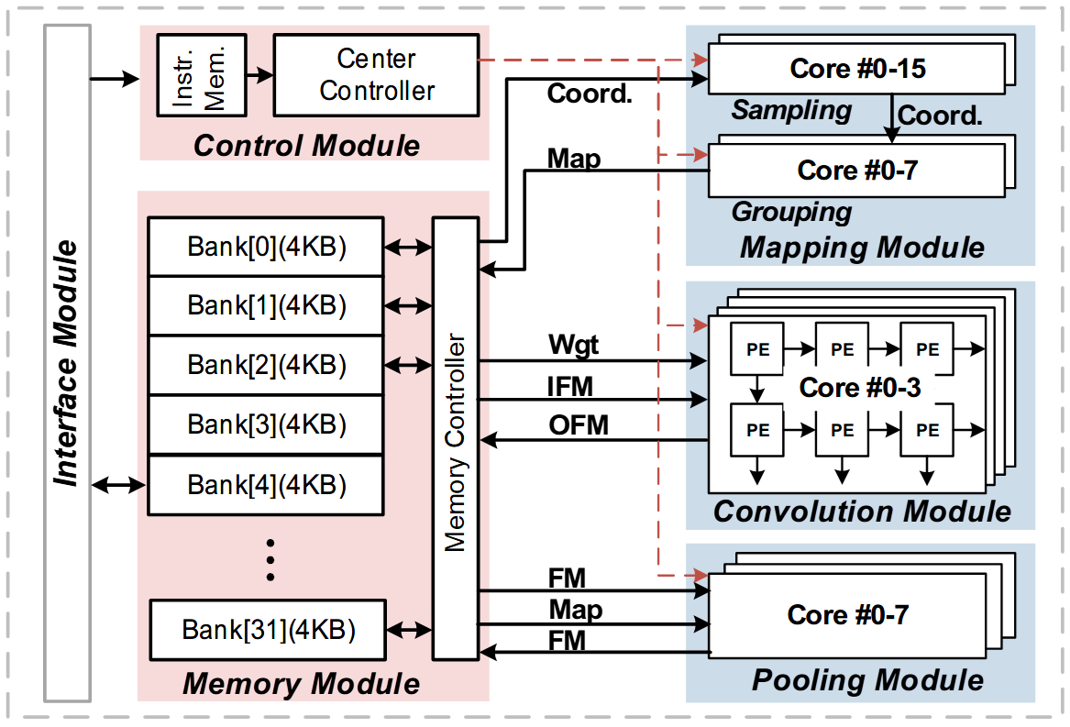
Experiment Setup
Hardware setup
TSMC 28-nm CMOS technology
0.9 V supply voltage
100 MHz
Cadence Genus
Vector-based power analysis
Benchmark
8-bit PointNeXt-S network
ModelNet40 dataset
Notes:
The proposed accelerator is implemented in the TSMC 28-nm CMOS technology. Cadence Genus is used for synthesis and power evaluation. The benchmark is the 8-bit PointNeXt network classifying ModelNet40 dataset.

Slide 27
Area and Energy Consumption Breakdown
Area (1.46 mm²)
Memory module: 58.6%
Convolution module: 27.7%
Mapping module: 11.4%
Energy consumption (0.13 mJ/Frame)
Convolution module: 63.5%
Mapping module: 3.5%
Memory module: 32%
12.65 TOPS/W energy efficiency
Notes:
This is the area and energy consumption breakdown of the proposed accelerator. The total area is one point four six square milimeter and energy consumption is 0.13 millijoule per frame. Memory module and convolution module dominate area and energy consumption, respectively. The proposed accelerator achieves 12.65 TOPS/W energy efficiency.

Slide 28
Effectiveness of the Proposed Techniques
Speed:
Energy Efficiency:
1
1.07×
8.53×
15.32×
1
5.51×
12.52×
13.6×
Notes:
Compared with the baseline, three techniques improve speedup and energy efficiency by fifteen point three two times speed up and thirteen point six times, respectively.

Slide 29
Comparison with the State of the Art
Energy efficiency: 2.2× ~ 66.6× ↑
Energy consumption: 50% ~ 98.6% ↓
Overall efficiency: 3.9× ~ 127.5× ↑
Y. Feng et al., MICRO, 2020, pp. 1037-1050.
14. Y. Feng et al., ISCA, 2022, pp. 962-977.
11. Y. Lin et al., MICRO, 2021, pp. 449-461.
10. S. Kim et al., Symp. VLSI Circuits, 2021.
15. Q. Cao et al., Symp. VLSI Circuits, 2022, pp. 106-107.
16. W. Sun et al., ISSCC, 2023, pp. 328-310.
13. J.-F. Zhang et al., MICRO, 2021, pp. 1078-1090.\
Notes:
Compared with the state-of-the-art accelerators, the proposed accelerator improves energy efficiency by up to sixty-six point six times, reduce energy consumption by up to 98.6%, and improve overall efficiency by up to seventy-four point nine times.

Slide 30
Outline
Introduction
Optimization Techniques
Experimental Results
Conclusions

Slide 31
Conclusions
An Energy-Efficient 3D Point Cloud Neural Network Accelerator
Efficient filter pruning (EFP)
Skip redundant convolutions of zero-value channels
Reduces 91.9% computation complexity and 96.6% model parameters
Block-wise MLP fusion (BMF)
Increase on-chip reuse of features
Reduce 95.3% off-chip memory access
Dual-Stream Block-wise FPS (DSBF)
Improve computation parallelism and maintain accuracy
Reduce 93% FPS computational complexity with negligible accuracy impact
12.65 TOPS/W energy efficiency with up to 66.6× energy efficiency improvement and 98.6% energy consumption reduction, compared with SOTA
Notes:
Finally, I’d like to conclude my talk today. An energy-efficient real-time PNN accelerator is proposed. An efficient filter pruning is proposed to skip redundant convolution of zero-value channel. Then, a block-wise MLP fusion is proposed to increase the on-chip reuse of features. Finally, a dual-stream block-wise FPS method is proposed to improve the parallelism of sampling and maintain the inference accuracy. With all techniques, the proposed accelerator achieves 12.65 TOPS/W energy efficiency with up to 66.6× energy efficiency improvement and 98.6% energy consumption reduction compared with SOTAs. thereby provide an attractive option for point cloud analysis at the edge
Thank you for listening.

Slide 32
Thank you!
Mr. Changchun Zhou
Ph. D. Candidate
zhouchch@pku.edu.cn
Supervisor: Prof. Hailong Jiao
School of Electronic and Computer Engineering
Shenzhen Graduate School, Peking University
Shenzhen, China

